Slide 1
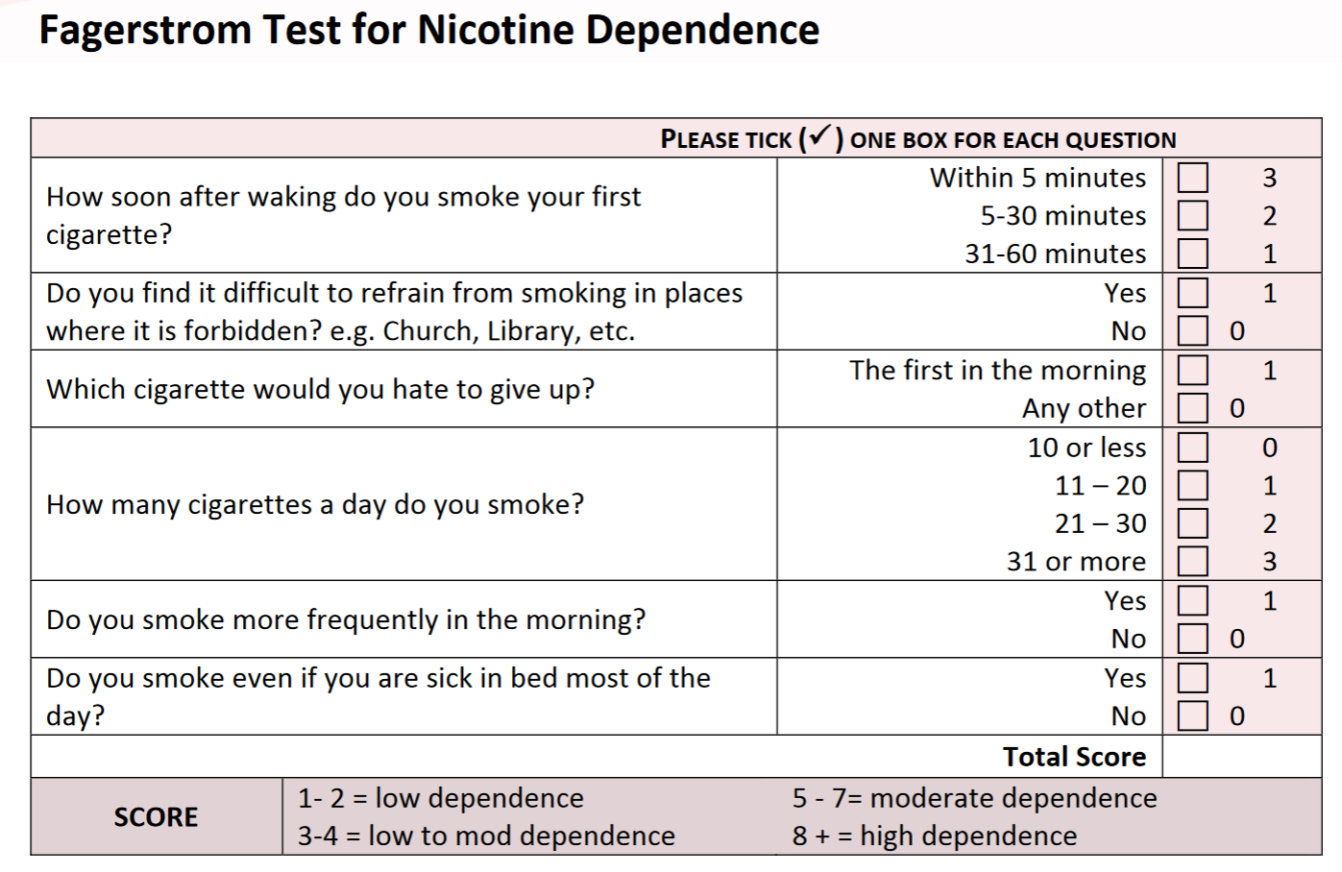
High abstinence rates from a smoking cessation program embedded within an HIV clinic
Mehri McKellar¹, Arvind Sivashanmugam², Eric Langhans², Kathryn Keicher¹, Leah Thomas², Jillian Dirkes², Kristen Dicks¹, James Davis²
Division of Infectious Diseases¹, Duke Center for Smoking Cessation²; Duke University Medical Center, Durham, North Carolina
PEB0228
Introduction & Objectives
Baseline Demographic, HIV and Smoking Data (n=62*)
Demographics
Mean age | 50.31 years (SD=10.61)
Male | 74.19%
Black or African American | 56.45%
Non-Hispanic | 93.55%
Private insurance | 29.03%
Public insurance | 51.61%
Uninsured | 19.35%
HIV measures
Current CD4 count >200 cells/mm³ | 93%
Current HIV-1 RNA < 50 copies/mL | 87%
Baseline smoking measures (mean)
# cigarettes/day | 16.22 (SD=8.38)
Pack-years ** | 25.03 (SD=17.91)
Expired carbon monoxide (CO) level *** | 18.02 ppm (SD=11.68)
Fagerstrom Test of Nicotine Dependence | 4.31 (SD=2.25)
Results
N=14
N=7
Effective ART has prolonged life expectancy among people living with HIV (PLWH) such that HIV is now considered a chronic, non-fatal disease. Unfortunately, the prevalence of smoking among PLWH is 2-4 times higher than that of the general U.S. population.¹⁻⁴ The incidence of smoking-related disease, including coronary disease, chronic lung disease, and lung cancer, is very high and constitutes the leading cause of death in PLWH.⁵⁻⁹ Smoking is associated with ART non-adherence and treatment failure, HIV-associated symptoms, depression and illicit substance use.^{3, 10-11} PLWH face multiple barriers to quitting including high rates of comorbid psychiatric illnesses and low socioeconomic status. Given the high morbidity and mortality, there is an urgent need to develop and offer effective smoking cessation treatment for PLWH.
400 smokers with HIV were referred to the Duke ID Smoking Cessation Clinic between December 2017-April 2019.
62 completed an initial visit (16%).
32 completed at least one follow-up visit (52%).
Among the patients with data available on a quit attempt, 37% demonstrated smoking abstinence confirmed by expired breath carbon monoxide <7 ppm.
Conclusions
The Duke ID Smoking Cessation Clinic provides intensive face-to-face treatment for smoking. Embedded within the Duke ID Clinic, this program is tailored to the needs of PLWH.
In the last two years, patients were mostly black males with well-controlled HIV, who were heavy smokers with moderate nicotine dependence.
Those who attended a follow-up visit showed a smoking abstinence rate of 37% which is higher than that seen with other common approaches: self-directed quit attempt <5%, provider-directed quit attempt 10-12%, and Quitlines 12%.
This abstinence rate is similar to abstinence rates seen in other programs sponsored by the Duke Center for Smoking Cessation (≈31%).
Our approach – a smoking cessation program embedded within an HIV clinic with medical and behavioral support -- is serving an important need for PLWH.
More work needs to be done on recruitment and retention to increase enrollment and engagement in a difficult-to-treat population.
Methods
The Duke Center for Smoking Cessation and the Duke ID Division partnered in December 2017 to develop the Duke ID Smoking Cessation Clinic.
The Duke ID Smoking Cessation Clinic is offered one half-day per week and is embedded within Clinic 1K (Duke HIV Clinic).
Patients are referred by ID providers and seen by an advanced practice provider from the Duke Center for Smoking Cessation in conjunction with a behavioral provider from Clinic 1K, and typically attend 1-6 clinic visits.
Medical treatments include nicotine replacement therapy (nicotine patch, gum, lozenge, inhaler), and oral medications (varenicline, bupropion, and clonidine).
Smoking status is confirmed by carbon-monoxide (CO) breath test at each visit.
Behavioral treatments include cognitive behavioral therapy, motivational interviewing strategies, and phone-based follow up.
Since March 2020 – this clinic has moved to a fully telemedicine-based structure.
Here we report on results from the Duke ID Smoking Cessation Clinic from a two-year period.
* Data from December 2017-April 2019
** 1 pack-year is equal to smoking 20 cigarettes (1 pack) per day for 1 year, or e.g. 40 cigarettes per day for half a year.
*** CO breath test: abstinence <7 parts per million (ppm)
SD=standard deviation
Impact of COVID-19
Since March 2020, the Duke ID Smoking Cessation Clinic has been moved a telemedicine-based clinic for both the behavioral and medical components.
It will be important to measure the effect of switching to a telemedicine-based clinic in the era of COVID-19, and whether this has a positive impact on enrollment and adherence.
REFERENCES: 1. Mdodo R, et al. Annals of Internal Medicine. 2015. 2. Vijayaraghavan M, et al. AIDS and Behavior. 2014. 3. Pacek LR, et al. The American Journal on Addictions. 2014. 4. Jamal A, et al. MMWR. 2014. 5. Yanik EL, et al. AIDS. 2016. 6. Reddy KP, et al. JAMA Intern Med. 2017. 7. Vandenhende M-A, et al. PLoS ONE. 2015. 8. Rasmussen LD, et al. Clinical Infectious Diseases. 2015. 9. Crothers K, et al. Chest. 2006. 10. Feldman JG, et al. American Journal of Public Health. 2006. 11. Shuter J, et al. Nicotine & Tobacco Research. 2008.

